Slide 1
Chapter 2:
Basic Elements of C++

Slide 2
Objectives
In this chapter, you will:
  Become familiar with the basic components of a C++ program, including functions, special symbols, and identifiers in C++
  Explore simple data types
  Discover how to use arithmetic operators
  Examine how a program evaluates arithmetic expressions
  Become familiar with the string data type
  Learn what an assignment statement is and what it does
C++ Programming: Program Design Including Data Structures, Seventh Edition

Slide 3
Objectives (cont’d.)
  Learn about variable declaration
  Discover how to input data into memory using input statements
  Become familiar with the use of increment and decrement operators
  Examine ways to output results using output statements
  Learn how to use preprocessor directives and why they are necessary
C++ Programming: Program Design Including Data Structures, Seventh Edition

Slide 4
Objectives (cont’d.)
  Learn how to debug syntax errors
  Explore how to properly structure a program, including using comments to document a program
  Become familiar with compound statements
  Learn how to write a C++ program
C++ Programming: Program Design Including Data Structures, Seventh Edition

Slide 5
Introduction
Computer program
  Sequence of statements whose objective is to accomplish a task
Programming
  Process of planning and creating a program
Real-world analogy: a recipe for cooking
C++ Programming: Program Design Including Data Structures, Seventh Edition

Slide 6
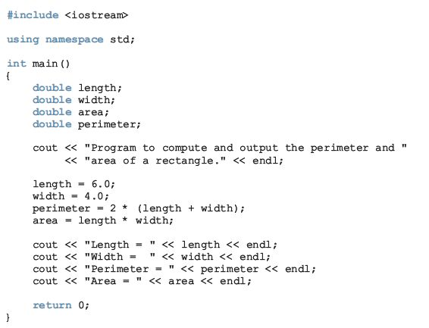
A Quick Look at a C++ Program
C++ Programming: Program Design Including Data Structures, Seventh Edition

Slide 7
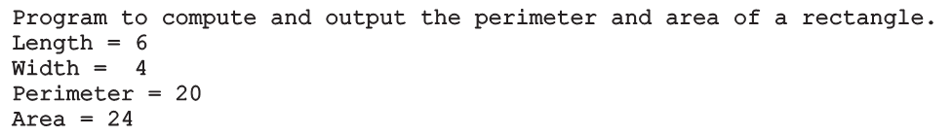
A Quick Look at a C++ Program (cont’d.)
Sample run:
C++ Programming: Program Design Including Data Structures, Seventh Edition

Slide 8
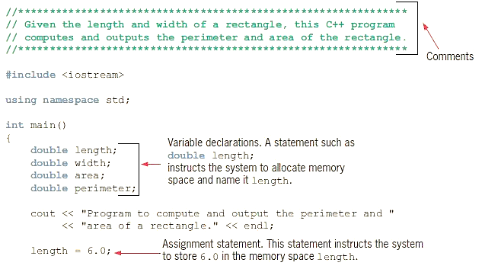
A Quick Look at a C++ Program (cont’d.)
C++ Programming: Program Design Including Data Structures, Seventh Edition

Slide 9
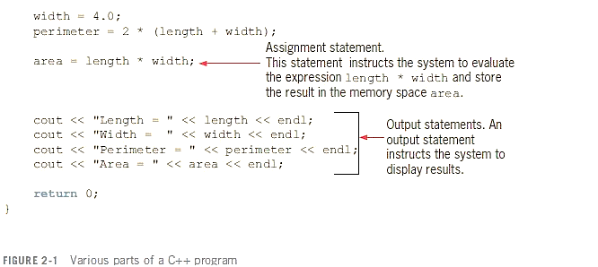
A Quick Look at a C++ Program(cont’d.)
C++ Programming: Program Design Including Data Structures, Seventh Edition

Slide 10


A Quick Look at a C++ Program(cont’d.)
Variable: a memory location whose contents can be changed
Figure 2-2 Memory allocation
Figure 2-3 Memory spaces after the statement length = 6.0; executes
C++ Programming: Program Design Including Data Structures, Seventh Edition

Slide 11
The Basics of a C++ Program
Function (or subprogram): collection of statements; when executed, accomplishes something
  May be predefined or standard
Syntax rules: rules that specify which statements (instructions) are legal or valid
Semantic rules: determine the meaning of the instructions
Programming language: a set of rules, symbols, and special words
C++ Programming: Program Design Including Data Structures, Seventh Edition

Slide 12
Comments
Comments are for the reader, not the compiler
Two types:
  Single line: begin with //
    // This is a C++ program.
    // Welcome to C++ Programming.
  Multiple line: enclosed between /* and */
    /*
    You can include comments that can
    occupy several lines.
    */
C++ Programming: Program Design Including Data Structures, Seventh Edition

Slide 13

Special Symbols
Token: the smallest individual unit of a program written in any language
C++ tokens include special symbols, word symbols, and identifiers
Special symbols in C++ include:
C++ Programming: Program Design Including Data Structures, Seventh Edition

Slide 14
Reserved Words (Keywords)
Reserved word symbols (or keywords):
  Cannot be redefined within program
  Cannot be used for anything other than their intended use
  Examples:
      int
      float
      double
      char
      const
      void
      return
C++ Programming: Program Design Including Data Structures, Seventh Edition

Slide 15
Identifiers
Identifier: the name of something that appears in a program
  Consists of letters, digits, and the underscore character (_)
  Must begin with a letter or underscore
C++ is case sensitive
  NUMBER is not the same as number
Two predefined identifiers are cout and cin
Unlike reserved words, predefined identifiers may be redefined, but it is not a good idea
C++ Programming: Program Design Including Data Structures, Seventh Edition

Slide 16
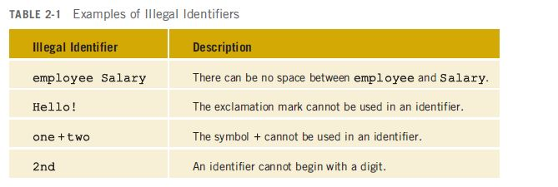
Identifiers (cont’d.)
Legal identifiers in C++:
  first
  conversion
  payRate
C++ Programming: Program Design Including Data Structures, Seventh Edition

Slide 17
Whitespaces
Every C++ program contains whitespaces
  Include blanks, tabs, and newline characters
Used to separate special symbols, reserved words, and identifiers
Proper utilization of whitespaces is important
  Can be used to make the program more readable
C++ Programming: Program Design Including Data Structures, Seventh Edition

Slide 18
Data Types
Data type: set of values together with a set of operations
C++ data types fall into three categories:
  Simple data type
  Structured data type
  Pointers
C++ Programming: Program Design Including Data Structures, Seventh Edition

Slide 19
Simple Data Types
Three categories of simple data
  Integral: integers (numbers without a decimal)
    Can be further categorized:
      char, short, int, long, bool, unsigned char, unsigned short, unsigned int, unsigned long
  Floating-point: decimal numbers
  Enumeration type: user-defined data type
C++ Programming: Program Design Including Data Structures, Seventh Edition

Slide 20
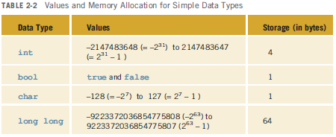
Simple Data Types (cont’d.)
Different compilers may allow different ranges of values
C++ Programming: Program Design Including Data Structures, Seventh Edition

Slide 21
int Data Type
Examples:
  -6728
  0
  78
  +763
Cannot use a comma within an integer
  Commas are only used for separating items in a list
C++ Programming: Program Design Including Data Structures, Seventh Edition

Slide 22
bool Data Type
bool type
  Two values: true and false
  Manipulate logical (Boolean) expressions
true and false
  Logical values
bool, true, and false
  Reserved words
C++ Programming: Program Design Including Data Structures, Seventh Edition

Slide 23
char Data Type
The smallest integral data type
Used for single characters: letters, digits, and special symbols
Each character is enclosed in single quotes
  'A', 'a', '0', '*', '+', '$', '&'
A blank space is a character
  Written ' ', with a space left between the single quotes
C++ Programming: Program Design Including Data Structures, Seventh Edition

Slide 24
char Data Type (cont’d.)
Different character data sets exist
ASCII: American Standard Code for Information Interchange
  Each of 128 values in ASCII code set represents a different character
  Characters have a predefined ordering based on the ASCII numeric value
Collating sequence: ordering of characters based on the character set code
C++ Programming: Program Design Including Data Structures, Seventh Edition

Slide 25
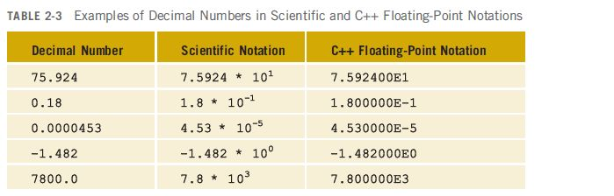
Floating-Point Data Types
C++ uses scientific notation to represent real numbers (floating-point notation)
C++ Programming: Program Design Including Data Structures, Seventh Edition

Slide 26
Floating-Point Data Types (cont’d.)
float: represents any real number
  Range: -3.4E+38 to 3.4E+38 (four bytes)
double: represents any real number
  Range: -1.7E+308 to 1.7E+308 (eight bytes)
Minimum and maximum values of data types are system dependent
C++ Programming: Program Design Including Data Structures, Seventh Edition

Slide 27
Floating-Point Data Types (cont’d.)
Maximum number of significant digits (decimal places) for float values: 6 or 7
Maximum number of significant digits for double: 15
Precision: maximum number of significant digits
  Float values are called single precision
  Double values are called double precision
C++ Programming: Program Design Including Data Structures, Seventh Edition

Slide 28
Data Types Variables, and Assignment Statements
To declare a variable, must specify its data type
Syntax: dataType identifier;
Examples:
int counter;
double interestRate;
char grade;
Assignment statement: variable = expression
interestRate = 0.05;
C++ Programming: Program Design Including Data Structures, Seventh Edition

Slide 29
Arithmetic Operators, Operator
Precedence, and Expressions
C++ arithmetic operators:
  + addition
  - subtraction
  * multiplication
  / division
  % modulus (or remainder) operator
+, -, *, and / can be used with integral and floating-point data types
Use % only with integral data types
C++ Programming: Program Design Including Data Structures, Seventh Edition

Slide 30
Arithmetic Operators, Operator Precedence, and Expressions (cont’d.)
When you use / with integral data types, the integral result is truncated (no rounding)
Arithmetic expressions: contain values and arithmetic operators
Operands: the number of values on which the operators will work
Operators can be unary (one operand) or binary (two operands)
C++ Programming: Program Design Including Data Structures, Seventh Edition

Slide 31
Order of Precedence
All operations inside of () are evaluated first
*, /, and % are at the same level of precedence and are evaluated next
+ and – have the same level of precedence and are evaluated last
When operators are on the same level
  Performed from left to right (associativity)
3 * 7 - 6 + 2 * 5 / 4 + 6 means
  (((3 * 7) – 6) + ((2 * 5) / 4 )) + 6
C++ Programming: Program Design Including Data Structures, Seventh Edition

Slide 32
Expressions
Integral expression: all operands are integers
  Yields an integral result
  Example: 2 + 3 * 5
Floating-point expression: all operands are floating-point
  Yields a floating-point result
  Example: 12.8 * 17.5 - 34.50
C++ Programming: Program Design Including Data Structures, Seventh Edition

Slide 33
Mixed Expressions
Mixed expression:
  Has operands of different data types
  Contains integers and floating-point
Examples of mixed expressions:
  2 + 3.5
  6 / 4 + 3.9
  5.4 * 2 – 13.6 + 18 / 2
C++ Programming: Program Design Including Data Structures, Seventh Edition

Slide 34
Mixed Expressions (cont’d.)
Evaluation rules:
  If operator has same types of operands
    Evaluated according to the type of the operands
  If operator has both types of operands
    Integer is changed to floating-point
    Operator is evaluated
    Result is floating-point
  Entire expression is evaluated according to precedence rules
C++ Programming: Program Design Including Data Structures, Seventh Edition

Slide 35
Type Conversion (Casting)
Implicit type coercion: when value of one type is automatically changed to another type
Cast operator: provides explicit type conversion
  static_cast<dataTypeName>(expression)
C++ Programming: Program Design Including Data Structures, Seventh Edition

Slide 36
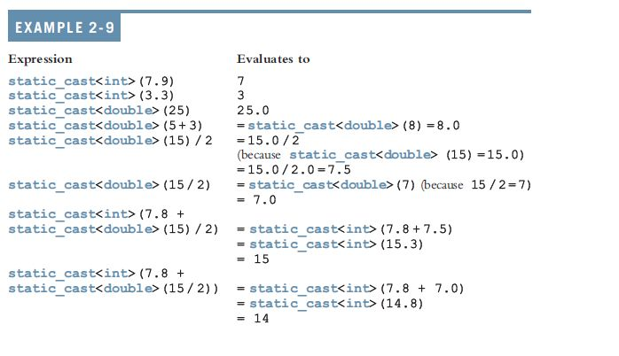
Type Conversion (cont’d.)
C++ Programming: Program Design Including Data Structures, Seventh Edition

Slide 37
string Type
Programmer-defined type supplied in ANSI/ISO Standard C++ library
Sequence of zero or more characters enclosed in double quotation marks
Null (or empty): a string with no characters
Each character has a relative position in the string
  Position of first character is 0
Length of a string is number of characters in it
  Example: length of "William Jacob" is 13
C++ Programming: Program Design Including Data Structures, Seventh Edition

Slide 38
Variables, Assignment Statements, and Input Statements
Data must be loaded into main memory before it can be manipulated
Storing data in memory is a two-step process:
  Instruct computer to allocate memory
  Include statements to put data into memory
C++ Programming: Program Design Including Data Structures, Seventh Edition

Slide 39

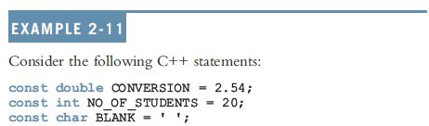
Allocating Memory with Constants and Variables
Named constant: memory location whose content can’t change during execution
Syntax to declare a named constant:
In C++, const is a reserved word
C++ Programming: Program Design Including Data Structures, Seventh Edition

Slide 40

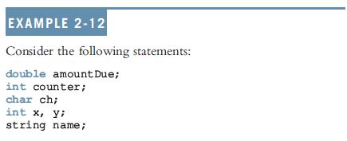
Allocating Memory with Constants and Variables (cont’d.)
Variable: memory location whose content may change during execution
Syntax to declare a named constant:
C++ Programming: Program Design Including Data Structures, Seventh Edition

Slide 41
Putting Data into Variables
Ways to place data into a variable:
  Use C++’s assignment statement
  Use input (read) statements
C++ Programming: Program Design Including Data Structures, Seventh Edition

Slide 42

Assignment Statement
The assignment statement takes the form:
Expression is evaluated and its value is assigned to the variable on the left side
A variable is said to be initialized the first time a value is placed into it
In C++, = is called the assignment operator
C++ Programming: Program Design Including Data Structures, Seventh Edition

Slide 43
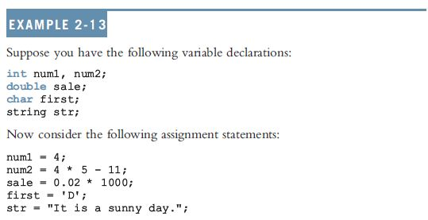
Assignment Statement (cont’d.)
C++ Programming: Program Design Including Data Structures, Seventh Edition

Slide 44
Saving and Using the Value of an Expression
To save the value of an expression:
  Declare a variable of the appropriate data type
  Assign the value of the expression to the variable that was declared
    Use the assignment statement
Wherever the value of the expression is needed, use the variable holding the value
C++ Programming: Program Design Including Data Structures, Seventh Edition

Slide 45
Declaring & Initializing Variables
Not all types of variables are initialized automatically
Variables can be initialized when declared:
  int first=13, second=10;
  char ch=' ';
  double x=12.6;
All variables must be initialized before they are used
  But not necessarily during declaration
C++ Programming: Program Design Including Data Structures, Seventh Edition

Slide 46

Input (Read) Statement
cin is used with >> to gather input
This is called an input (read) statement
The stream extraction operator is >>
For example, if miles is a double variable
cin >> miles;
  Causes computer to get a value of type double and places it in the variable miles
C++ Programming: Program Design Including Data Structures, Seventh Edition

Slide 47
Input (Read) Statement (cont’d.)
Using more than one variable in cin allows more than one value to be read at a time
Example: if feet and inches are variables of type int, this statement:
cin >> feet >> inches;
  Inputs two integers from the keyboard
  Places them in variables feet and inches respectively
C++ Programming: Program Design Including Data Structures, Seventh Edition

Slide 48

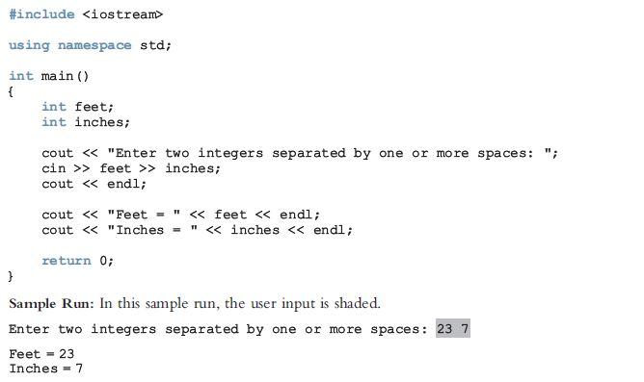
Input (Read) Statement (cont’d.)
C++ Programming: Program Design Including Data Structures, Seventh Edition

Slide 49
Increment and Decrement Operators
Increment operator: increase variable by 1
  Pre-increment: ++variable
  Post-increment: variable++
Decrement operator: decrease variable by 1
  Pre-decrement: --variable
  Post-decrement: variable—
What is the difference between the following?
x = 5;
y = ++x;
x = 5;
y = x++;
C++ Programming: Program Design Including Data Structures, Seventh Edition

Slide 50
Output
The syntax of cout and << is:
  Called an output statement
The stream insertion operator is <<
Expression evaluated and its value is printed at the current cursor position on the screen
C++ Programming: Program Design Including Data Structures, Seventh Edition

Slide 51
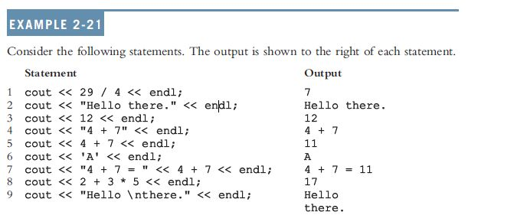
Output (cont’d.)
A manipulator is used to format the output
  Example: endl causes insertion point to move to beginning of next line
C++ Programming: Program Design Including Data Structures, Seventh Edition

Slide 52
Output (cont’d.)
The new line character is '\n'
  May appear anywhere in the string
    cout << "Hello there.";
    cout << "My name is James.";
    Output:
    Hello there.My name is James.
    cout << "Hello there.\n";
    cout << "My name is James.";
    Output :
    Hello there.
    My name is James.
C++ Programming: Program Design Including Data Structures, Seventh Edition

Slide 53
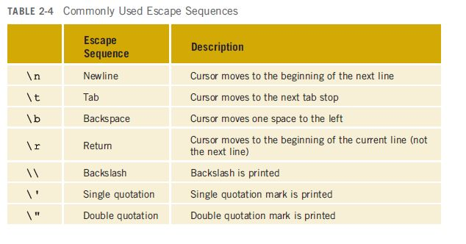
Output (cont’d.)
C++ Programming: Program Design Including Data Structures, Seventh Edition

Slide 54
Preprocessor Directives
C++ has a small number of operations
Many functions and symbols needed to run a C++ program are provided as collection of libraries
Every library has a name and is referred to by a header file
Preprocessor directives are commands supplied to the preprocessor program
All preprocessor commands begin with #
No semicolon at the end of these commands
C++ Programming: Program Design Including Data Structures, Seventh Edition

Slide 55

Preprocessor Directives (cont’d.)
Syntax to include a header file:
For example:
#include <iostream>
  Causes the preprocessor to include the header file iostream in the program
Preprocessor commands are processed before the program goes through the compiler
C++ Programming: Program Design Including Data Structures, Seventh Edition

Slide 56
namespace and Using cin and cout in a Program
cin and cout are declared in the header file iostream, but within std namespace
To use cin and cout in a program, use the following two statements:
#include <iostream>
using namespace std;
C++ Programming: Program Design Including Data Structures, Seventh Edition

Slide 57
Using the string Data Type in a Program
To use the string type, you need to access its definition from the header file string
Include the following preprocessor directive:
#include <string>
C++ Programming: Program Design Including Data Structures, Seventh Edition

Slide 58
Creating a C++ Program
A C++ program is a collection of functions, one of which is the function main
The first line of the function main is called the heading of the function:
  int main()
The statements enclosed between the curly braces ({ and }) form the body of the function
C++ Programming: Program Design Including Data Structures, Seventh Edition

Slide 59
Creating a C++ Program (cont’d.)
A C++ program contains two types of statements:
  Declaration statements: declare things, such as variables
  Executable statements: perform calculations, manipulate data, create output, accept input, etc.
C++ Programming: Program Design Including Data Structures, Seventh Edition

Slide 60
Creating a C++ Program (cont’d.)
C++ program has two parts:
  Preprocessor directives
  The program
Preprocessor directives and program statements constitute C++ source code (.cpp)
Compiler generates object code (.obj)
Executable code is produced and saved in a file with the file extension .exe
C++ Programming: Program Design Including Data Structures, Seventh Edition

Slide 61
Debugging: Understanding and Fixing Syntax Errors
Compile a program
  Compiler will identify the syntax errors
  Specifies the line numbers where the errors occur
    Example2_Syntax_Errors.cpp
    c:\chapter 2 source code\example2_syntax_errors.cpp(9) : error C2146: syntax error :
    missing ';' before identifier 'num'
    c:\chapter 2 source code\example2_syntax_errors.cpp(11) : error C2065: 'tempNum' :
    undeclared identifier
C++ Programming: Program Design Including Data Structures, Seventh Edition

Slide 62
Program Style and Form: Syntax
Syntax rules: indicate what is legal and what is not legal
Errors in syntax are found in compilation
  int x; //Line 1
  int y //Line 2: error
  double z; //Line 3
  y = w + x; //Line 4: error
C++ Programming: Program Design Including Data Structures, Seventh Edition

Slide 63
Use of Blanks
In C++, you use one or more blanks to separate numbers when data is input
Blanks are also used to separate reserved words and identifiers from each other and from other symbols
Blanks must never appear within a reserved word or identifier
C++ Programming: Program Design Including Data Structures, Seventh Edition

Slide 64
Use of Semicolons, Brackets, and Commas
All C++ statements end with a semicolon
  Also called a statement terminator
{ and } are not C++ statements
  Can be regarded as delimiters
Commas separate items in a list
C++ Programming: Program Design Including Data Structures, Seventh Edition

Slide 65
Semantics
Semantics: set of rules that gives meaning to a language
  Possible to remove all syntax errors in a program and still not have it run
  Even if it runs, it may still not do what you meant it to do
Ex: 2 + 3 * 5 and (2 + 3) * 5
are both syntactically correct expressions, but have different meanings
C++ Programming: Program Design Including Data Structures, Seventh Edition

Slide 66
Naming Identifiers
Identifiers can be self-documenting:
  CENTIMETERS_PER_INCH
Avoid run-together words :
  annualsale
  Solution:
    Capitalizing the beginning of each new word: annualSale
    Inserting an underscore just before a new word: annual_sale
C++ Programming: Program Design Including Data Structures, Seventh Edition

Slide 67
Prompt Lines
Prompt lines: executable statements that inform the user what to do
  cout << "Please enter a number between 1 and 10 and "
  << "press the return key" << endl;
  cin >> num;
Always include prompt lines when input is needed from users
C++ Programming: Program Design Including Data Structures, Seventh Edition

Slide 68
Documentation
A well-documented program is easier to understand and modify
You use comments to document programs
Comments should appear in a program to:
  Explain the purpose of the program
  Identify who wrote it
  Explain the purpose of particular statements
C++ Programming: Program Design Including Data Structures, Seventh Edition

Slide 69
Form and Style
Consider two ways of declaring variables:
  Method 1
int feet, inch;
double x, y;
  Method 2
  int feet,inch;double x,y;
Both are correct; however, the second is hard to read
C++ Programming: Program Design Including Data Structures, Seventh Edition

Slide 70
More on Assignment Statements
Two forms of assignment
  Simple and compound
  Compound operators provide more concise notation
Compound operators: +=, -=, *=, /=, %=
Simple assignment
x = x * y;
Compound assignment
x *= y;
C++ Programming: Program Design Including Data Structures, Seventh Edition

Slide 71
Summary
C++ program: collection of functions, one of which is always called main
Identifiers consist of letters, digits, and underscores, and begins with letter or underscore
The arithmetic operators in C++ are addition (+), subtraction (-), multiplication (*), division (/), and modulus (%)
Arithmetic expressions are evaluated using the precedence associativity rules
C++ Programming: Program Design Including Data Structures, Seventh Edition

Slide 72
Summary (cont’d.)
All operands in an integral expression are integers
All operands in a floating-point expression are decimal numbers
Mixed expression: contains both integers and decimal numbers
Use the cast operator to explicitly convert values from one data type to another
A named constant is initialized when declared
All variables must be declared before used
C++ Programming: Program Design Including Data Structures, Seventh Edition

Slide 73
Summary (cont’d.)
Use cin and stream extraction operator >> to input from the standard input device
Use cout and stream insertion operator << to output to the standard output device
Preprocessor commands are processed before the program goes through the compiler
A file containing a C++ program usually ends with the extension .cpp
C++ Programming: Program Design Including Data Structures, Seventh Edition

